Slide 1

MALL MANAGEMENT SYSTEM
Presented by
Abdullah Shahid (BSSE-24001)
Hussain Daud Syed (BSSE-24021)
Muhammad Uzair Qazi (BSSE-24044)
Muhammad Hassan Ali (BSSE-24038)
Muhammad Muzahir Abbas (BSSE-24060)

Slide 2

ABDULLAH SHAHID
(Store Management + Inventory & Stock Management)
Store Management
This module focuses on managing different types of stores inside the mall. It handles store details, revenues, and data storage.
Inventory & Stock Management
This part ensures stores keep track of their stock efficiently. It allows monitoring stock levels and restocking when necessary.

Slide 3
HUSSAIN DAUD SYED
(Employee Management + Security & Access Control)
Employee Management
This module deals with employee records, including cashiers, security personnel, and managers. It ensures proper employee data management.
Security & Access Control
This system keeps track of security logs and manages access to different parts of the mall. It ensures safety and controlled access for employees and customers.

Slide 4
MUHAMMAD UZAIR QAZI
(Customer & Membership Management + Billing & Sales System)
Customer and Membership Management
This module handles customer profiles and memberships. It includes regular and VIP customers with different benefits.
Billing & Sales System
This section manages the checkout process, billing customers for their purchases, and keeping track of all sales transactions.

Slide 5
MUHAMMAD HASSAN ALI
(Parking Management + Advertisement & Promotions)
Parking Management
This module helps in managing parking slots, tracking vehicles, and maintaining parking records for the mall.
Advertisement & Promotions
It handles promotional campaigns and advertisements inside the mall, ensuring businesses can reach customers effectively.

Slide 6
MUHAMMAD MUZAHIR ABBAS
(Online Booking + Events & Entertainment Management)
Online Booking
This module enables customers to book services like movie tickets and restaurant reservations online.
Events & Entertainment Management
This part manages events happening in the mall, such as concerts and workshops, keeping track of schedules and attendees.

Slide 7
UML DIAGRAM

Slide 8
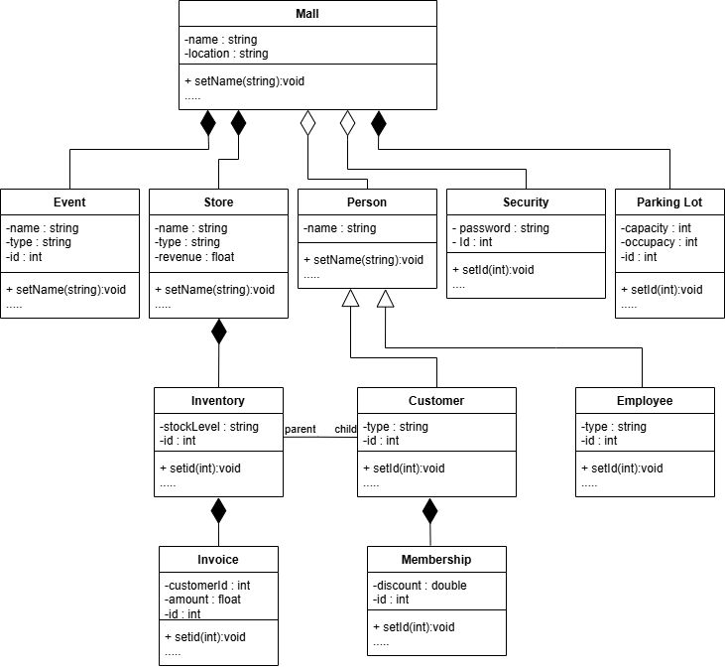

Slide 9

TOOLS TO BE USED
GITHUB
CYGWIN
CLION

Slide 10
THANK YOU

